Slide 1

Chinook's Growth Plan
A Strategic Blueprint for Boosting Loyalty and Sales Lift
Katepalli Deva Naga Sai Kumar

Slide 2
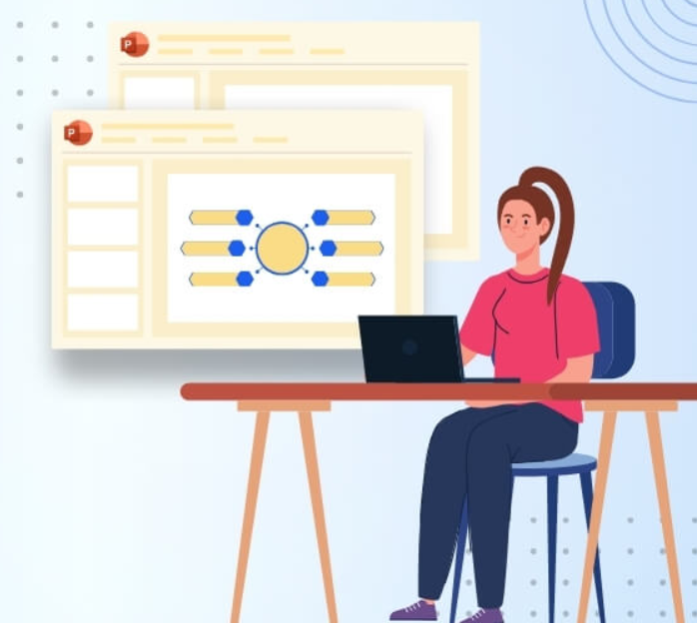
Agenda
Problem Objective
Data Description
Key Metrics and Visualizations
Recommendations

Slide 3

Our Mission
Analyze Chinook’s music sales data to uncover actionable insights.
Identify revenue drivers, customer behaviors, and retention risks.
Provide strategic recommendations to strengthen Chinook’s position in the music market.

Slide 4
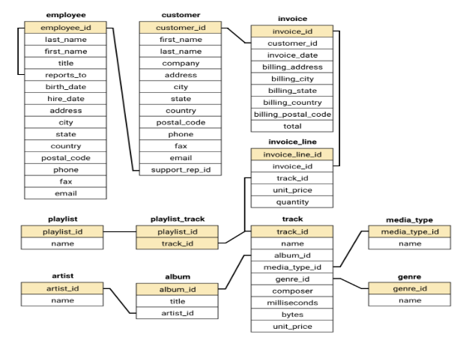
Database Schema

Slide 5
Data Understanding
The dataset provides the comprehensive view of Chinook market presence and operations
The dataset contains 11 relational tables containing information about company’s operations
Chinook has the global customer base across 24 countries.
The music catalog covers 24 genres such as Rock, Metal, Jazz, Classical and more.
Each track is associated with its album and artist enabling detailed analysis of music trends.
Invoice table captures all purchases, providing insights into sales and revenue.

Slide 6
Project Flow
Understanding the Data
Cleaning the Data
Exploring the Data
Deriving Key Insights

Slide 7
Data Gaps & Duplicates: Ensuring Analytical Integrity
Missing Values:
Customer: Company, Fax, State → replaced with “N/A”
Track: Composer → replaced with “Unknown”
Duplicates:
Found in invoice_line & playlist → handled with DISTINCT and aggregation
Critical Gaps:
Missing age, gender, campaign tracking
Limits demographic & ROI analysis → future enhancement needed

Slide 8
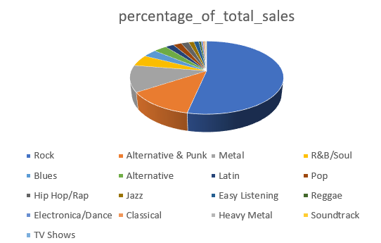
Rock's Dominance: Our Core Revenue Engine
Key Insights:
Rock = 50%+ of total sales in USA (largest market).
Dominates both volume and value.
Top-Selling Genres (USA):
🎸 Rock
🎤 Alternative & Punk
🤘 Metal
Top Artist (USA):
Leading artist(s) consistently from the Rock genre, reinforcing the trend.
Recommendation:
Allocate 60–70% of inventory & promotional budgets to Rock, Alternative, and Metal.

Slide 9
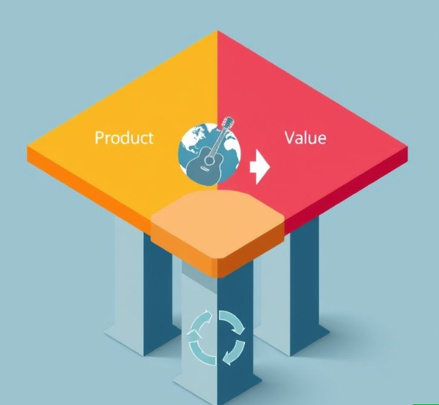
The Three Pillars of Growth: Product, Value, and Retention
Product Mix:
🎸 Rock, Alternative, and Metal = major revenue drivers → need priority in inventory & marketing.
Geographic Value:
🌍 Czech Republic & Ireland customers spend ~2× the USA average → niche markets with high value.
Retention Risk:
⏳ Low purchase frequency (<5) strongly signals customer churn.

Slide 10
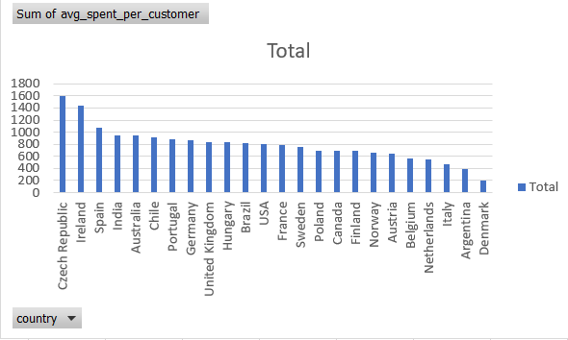
Premium Buyers: The Hidden Goldmine
Data Highlight:
Czech Republic: $1,591.92 avg. spend per customer (~2× USA).
Ireland: $1,433.52 avg. spend.
Behavior:
Highest track volumes (e.g., 138 in Czech Republic).
Spend more per track → albums & collector items preferred.
Recommendation:
🎯 Focus on exclusive, limited-edition releases.
📦 Launch collector bundles in premium markets.
Emphasize exclusivity > discounts.

Slide 11

Customer Churn Rate
Many Customers purchase only once -> high churn and weak retention
This poses a risk to long term revenue growth.
Launch targeted offers, promos and seasonal campaigns to drive repeat purchases.
Strengthen customer support to boost loyalty.

Slide 12
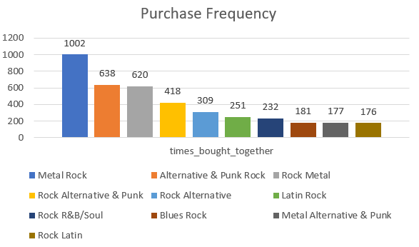
Product Affinity Analysis
Rock genre shows strong affinity with Metal, Alternative & Punk and R&B/Soul genres. These combinations present significant cross-selling opportunities.
Create genre bundles for increasing sales.
Marketing based on purchasing patterns

Slide 13
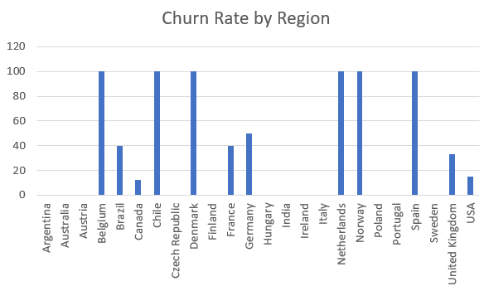
Regional Market Analysis
USA leads the way with the most customers, orders and revenue – Rock’s huge popularity drives this.
Canada follows closely, supported by a strong economy and English audiences.
Czech Republic surprises with the highest spending per order and most frequent purchases – true music enthusiasts!

Slide 14
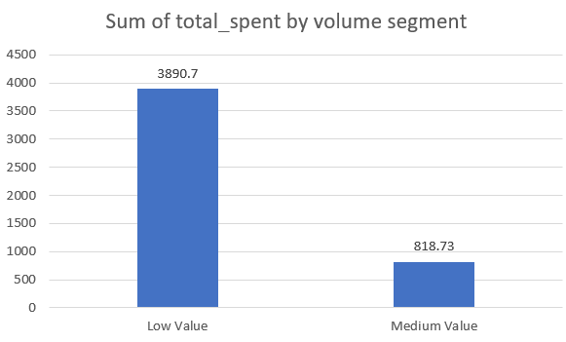
Customer Risk Profiling
Majority of Customers are classified as high risk due to long inactivity periods.
Even customers with frequent orders have Low Value, indicating low spending per order.
Countries like Denmark, Canada, Argentina, Italy, USA and Belgium have high-risk, low-value customers

Slide 15

Hooking Customers Early: The 5-Purchase Play
Recommendation:
Launch an Early Intervention Loyalty Program (EILP) targeting new customers immediately after their first purchase.
Goal:
Drive customers past the 5-purchase retention threshold.
Mechanics:
Tiered rewards for early purchases:
2nd purchase → personalized playlist
3rd purchase → exclusive content access
4th purchase → small discount
Focus = engagement & frequency, not just discounts.

Slide 16
Driving Growth: Focus & Action
Final Summary:
Reinforce Core Products: Rock & Alternative remain the revenue engine.
Tackle Churn: Focus on customer frequency to secure lifetime value.
Geo-Smart Marketing: Allocate budgets based on value, not just volume.
Next Steps:
Finalize EILP design and budget for early retention.
Launch limited-edition products in high-value markets (Czech Republic, Ireland).
Analyze Lapsed Customers to refine win-back campaigns based on album preferences.

Slide 17
THANK YOU

